Slide 1
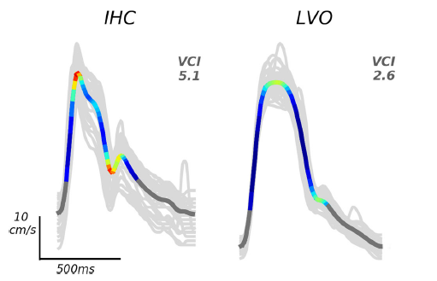
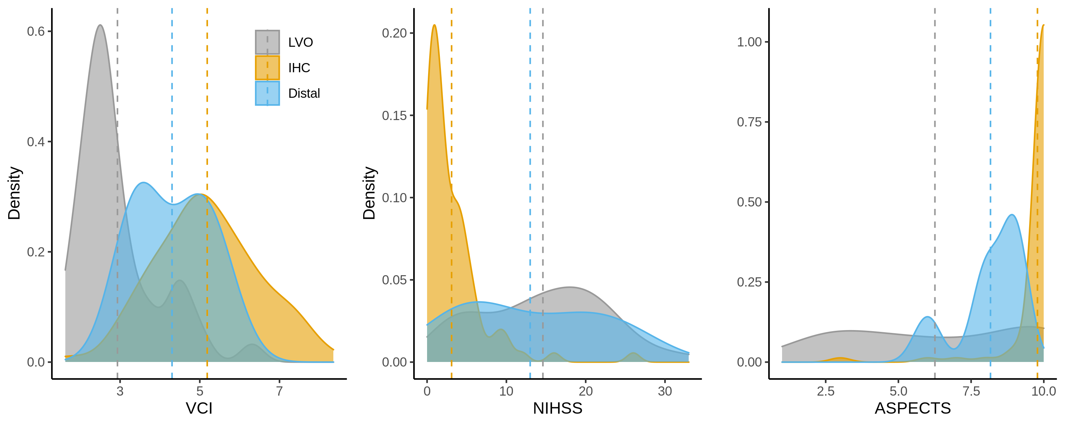
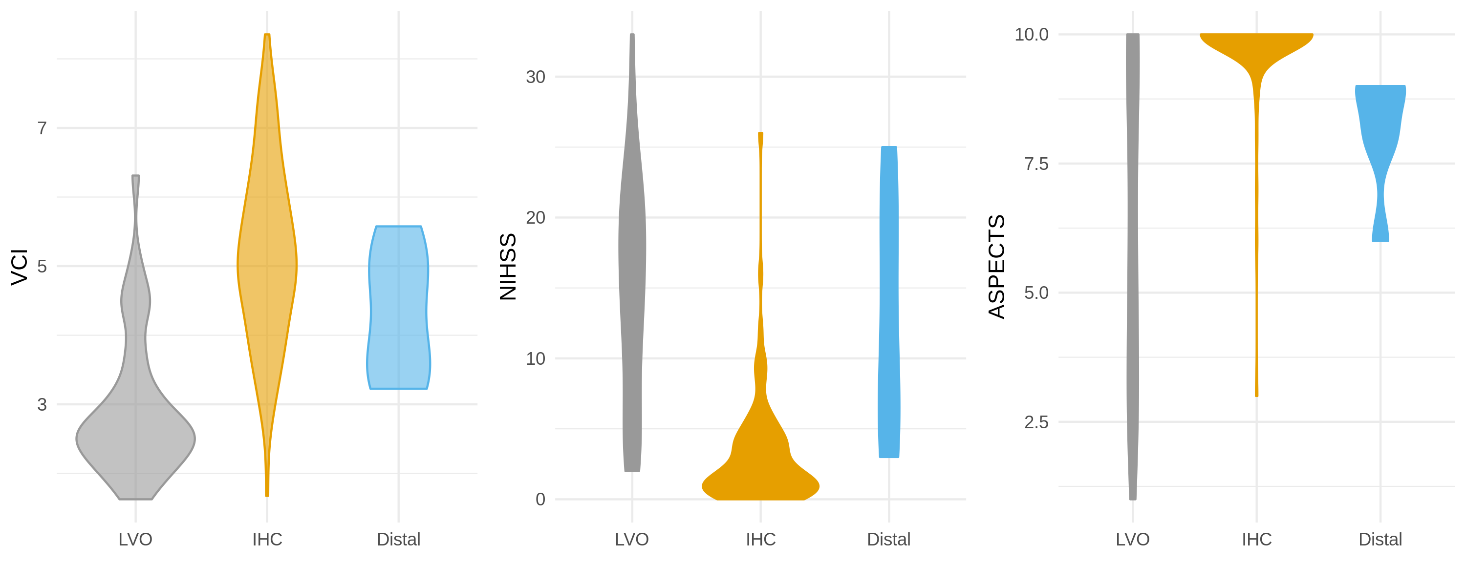
TCD Waveform Analysis For Differentiating Large-Vessel And Distal Occlusions
Corey M. Thibeault¹ │ Kian Jalaleddini¹ │ Samuel G. Thorpe¹ │ Nicolas Canac¹│ Amber Y. Dorn¹ │ Seth J. Wilk¹ │ Ruchir Shah¹ │ Thomas G. Devlin¹ │ Robert Hamilton¹
¹ NovaSignal Corporation. Los Angeles, CA USA ²Erlanger Neuroscience Institute. Chattanooga, TN USA
Introduction
Methods
results
Traditional transcranial Doppler (TCD) ultrasound metrics in the acute phase of large-vessel occlusion (LVO) diagnosis have been shown to provide complementary value to current standard-of-care triage modalities.
In addition to these metrics, pulse-level morphological features have also begun to show diagnostic utility. This study explores Velocity Curvature Index (VCI), one such morphological feature.
VCI is an application of curvature, which quantifies the degree to which a beat morphologically deviates from normal¹.
This reduces the dimensionality of a pulse and has shown discriminatory power when comparing LVO subjects (ICA, M1, M2, MCA segments) to controls.
Post-hoc analysis using Bonferroni correction found significant differences between LVO (2.83 ±0.92) and controls (5.09±1.14) [p<0.001], distal occlusion (3.97±1.13) and controls [p<0.05], as well as distal occlusion and LVO [p<0.05] groups.
Figure 1. Derivation of VCI from in-hospital control (IHC) and LVO subject TCD waveforms.
Statistical Analysis
Aims
The distribution of VCI in LVO, distal occlusion, and control groups was evaluated using a one-way ANOVA.
This study extends beyond that binary case to explore how VCI changes in subjects with distal occlusions (M3, M4, MCA segments, and lacunar).
Figure 3. Cumulative density plots of VCI (left), NIHSS (center), and ASPECTS (right) for the LVO group and the combined IHC and distal groups These plots illustrate the probability of belonging to a particular class along the observed range of each metric.
Methods
results
Patient Population and Data Collection
A one-way ANOVA revealed a significant effect of cohort on VCI [F(2, 75) = 41.76, p<0.001].
conclusions
The three cohorts were confirmed by CTA imaging and were comprised of LVO (n=36, 70±20.4 years, 52% male), distal occlusion (n=7, 67±14.6 years, 77% male), and controls (n=35, 57±16.5 years, 61% male).
In addition to standard imaging, bilateral TCD measurements of the middle cerebral artery were collected.
TCD waveforms were sampled at 30-s intervals and further processed by extracting the corresponding beats and resulting VCI for each subject.
In this case the distal occlusion group had VCI values between the LVO and control groups -- supporting VCI as a continuous estimate of vascular dysfunction.
Furthermore, the extension beyond binary discrimination illustrates the use of VCI as a complementary measure of ischemic stroke severity.
Velocity Curvature Index (VCI)
From the exam segments the morphological feature Velocity Curvature Index (VCI), which quantifies the degree that a pulse deviates from normal, is extracted.
We define MVP-VCI as the minimum VCI measured across the maximum velocity segments from each hemisphere.
Selected References
Figure 2. Distributions of VCI (left), NIHSS (center), and ASPECTS (right) for the LVO group and the combined IHC and distal groups
1. Thorpe SG, Thibeault CM, Wilk SJ, O’Brien M, Canac N, Ranjbaran M, Devlin C, Devlin T, Hamilton RB. Velocity Curvature Index: a Novel Diagnostic Biomarker for Large Vessel Occlusion. Transl Stroke Res. October 2018:1-10. doi:10.1007/s12975-018-0667-2
Questions?
corey@novasignal.com
For Research & Investigational Use Only. Not for Commercial Use.

